Slide 1
Who Should Get Screened for Colorectal Cancer?

Slide 2
If you are 50 years old, or older make sure that you meet with your doctor to discuss colorectal cancer.

Slide 3
Important questions to discuss with your doctor:
Do I need to be screened for colon cancer?

Slide 4
What are my risk factors for colon and/or rectal cancer?

Slide 5
What are the symptoms?

Slide 6
What are my screening options?

Slide 7
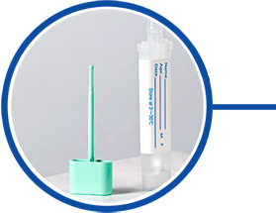
Polymedco Cancer Diagnostic Products, LLC
Polymedco’s FIT test detects blood in stool.
It is a simple, affordable, at home screening kit requiring a small stool sample.

Slide 8
Contact Us:
Polymedco Cancer Diagnostic Products, LLC
510 Furnace Dock Road
Cortlandt Manor, NY 10567
888 638 7757
tpucci@polymedco.com
www.cancerscreens.com

